Slide 1
Microsoft Threat Protection
Jason Weber, Distinguished Engineer

Slide 2
technical discussion

Slide 3

Morris Worm (1988)
Notes:
Morris Worm – Cornell University

Slide 4

WannaCry Ransomware (2017)
Notes:
Wannacry - Ransonware

Slide 5


Dridex Malspam (2015)
Notes:
Dridex – Malspam Trojan

Slide 6

Hillary Clinton Email (2016)
Notes:
John Email

Slide 7
businesses lose
$1M
per minute to cyber crime
Source: RiskIQ 2018.
Notes:
$1M per minute lost to cybercrime
Not news
Urgent and essential mission
Today is not just about bad news --- we will tell good stories

Slide 8
smart cities
behicles
sensors
energy systems
marketplaces
equipment
partners
customers
citizens
supply chains
on-premises
manufacturers
mobile devices
Notes:
First, bad actors getting smarter
Second, we need more of You.
Third, the landscape in more complex

Slide 9
Notes:
The cloud can help manage that complexity
Reality of your digital estate
Next generation of AI and automation to super-charge your work

Slide 10

Operations
Security operations that work for you
Microsoft Security
Technology
Partnerships
Enterprise-class intelligent security
Partnerships for a heterogeneous world
Notes:
At Microsoft, we spend about a billion dollars every year on research and development, and the way we think about it is, how can we do something that ensures productivity while securing your organization.
How can we simplify security and give you what other cloud solutions are not able to provide?
What is the additional capability that we can layer on top of what our partners have already done?
That shows up in three areas:
Operations
Technology
Partnerships
where we are working together with industry, enterprises and government to make our world safer

Slide 11
A secure foundation at global scale
Over 100 datacenters across the planet
Each physical datacenter protected with world-class, multi-layered protection
Secured with cutting-edge operational security
Restricted access
24x7 monitoring
Global security experts
Global cloud infrastructure with custom hardware and network protection
Notes:
It starts with operational excellence
Physical security
Operational security
Global cloud fabric that runs our clouds (Office365, Azure) and our security services

Slide 12
Microsoft Intelligent
Security Graph
Shared threat
data from partners,
researchers and law
Enforcement
worldwide
1.2B
devices scanned
each month
Malware data
from Windows
Defender
400B
emails analyzed
200+
global cloud
consumer and
Commercial
services
Botnet data from
Microsoft Digital
Crimes Unit
Enterprise
security for
90%
of Fortune 500
18B+
Bing web pages
scanned
1B+
Azure user
accounts
450B
monthly
authentications
Notes:
3,500 cyber professionals, industry security experts
Huge amounts of data
Humans are not good at this --- try to understand 1M!
Scale up to 6.5trillion / day
Scale, storage and compute
Sophisticated models from Data Analysts

Slide 13
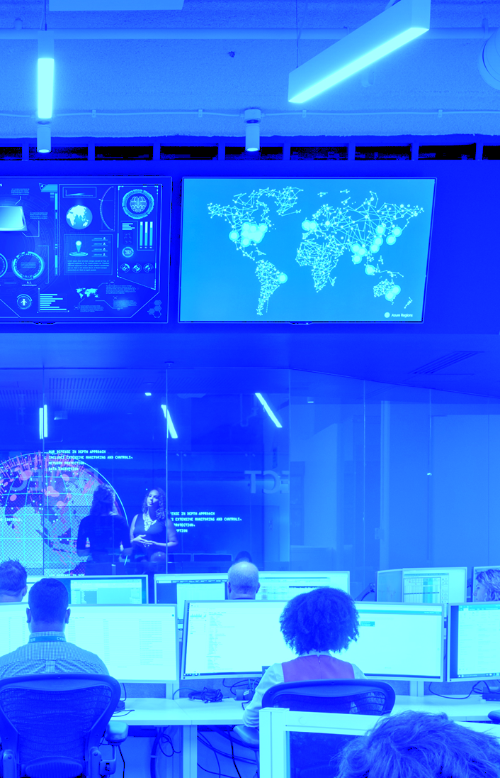
Stopping cyber attacks
Real-world intelligence at work
Emotet: Patient zero to quarantine in milliseconds
Ursnif: Spotting the needle in the haystack
Phishing campaigns
Notes:
It works – real world stories
WannaCry – Emotet – stopped within milliseconds
Another example ---Dofoil
Ursnif attack, which Satya talked about
Phish attacks, even better

Slide 14
Microsoft Threat Protection
Identities
Endpoints
User Data
Cloud Apps
Infrastructure
Intelligent Security Graph | 6.5 TRILLION signals per day
Notes:
Microsoft Threat Protection brings together
Powered by the Intelligent Security Graph

Slide 15
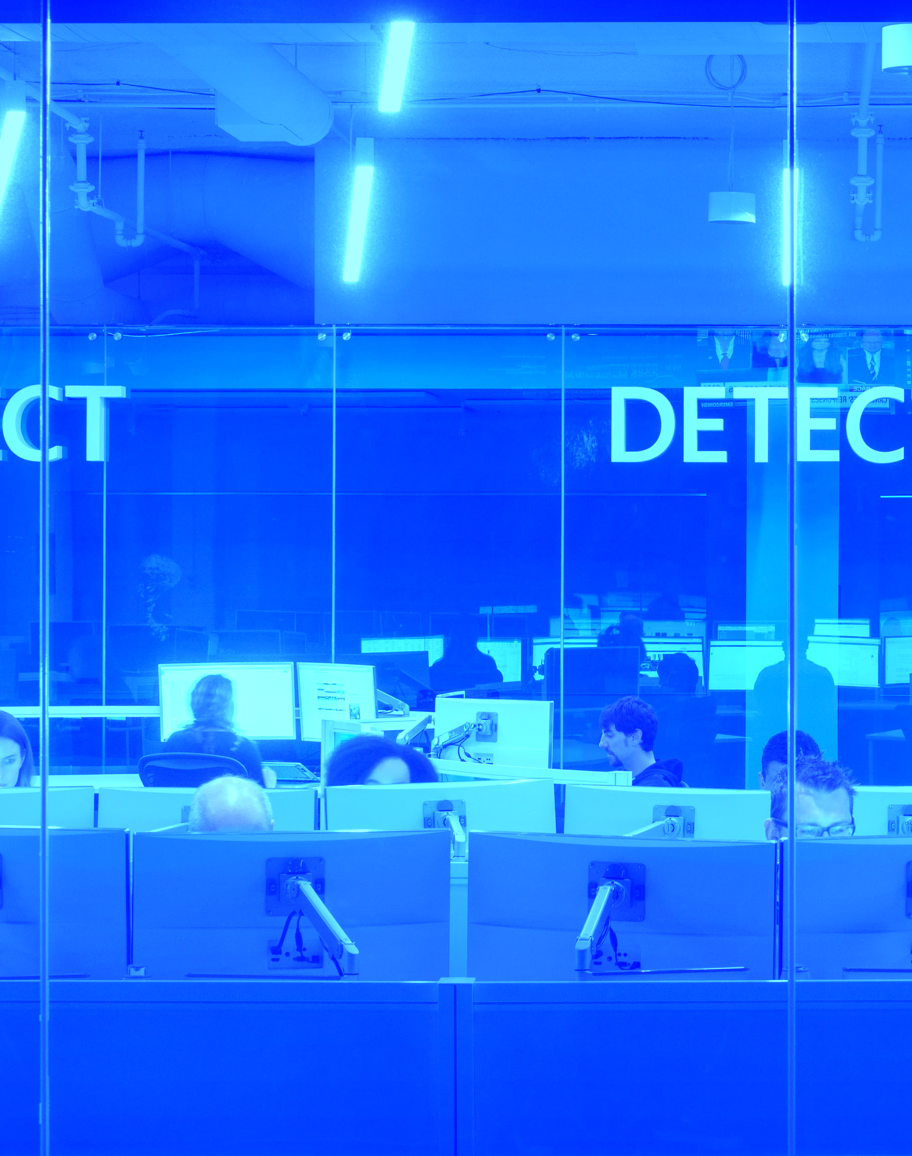
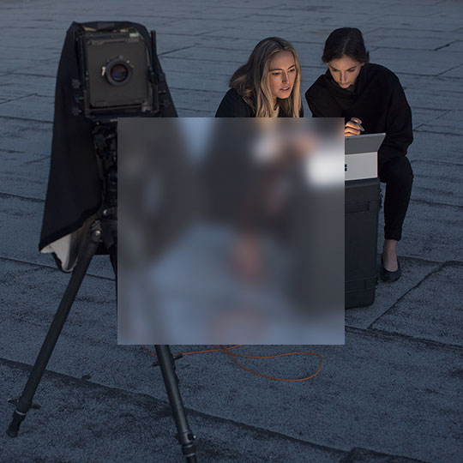
Threat protection
Disconnected tools
Integrated experiences
Alert fatigue
Correlated insights
Task overload
Automated workflows
Notes:
Walk all three

Slide 16
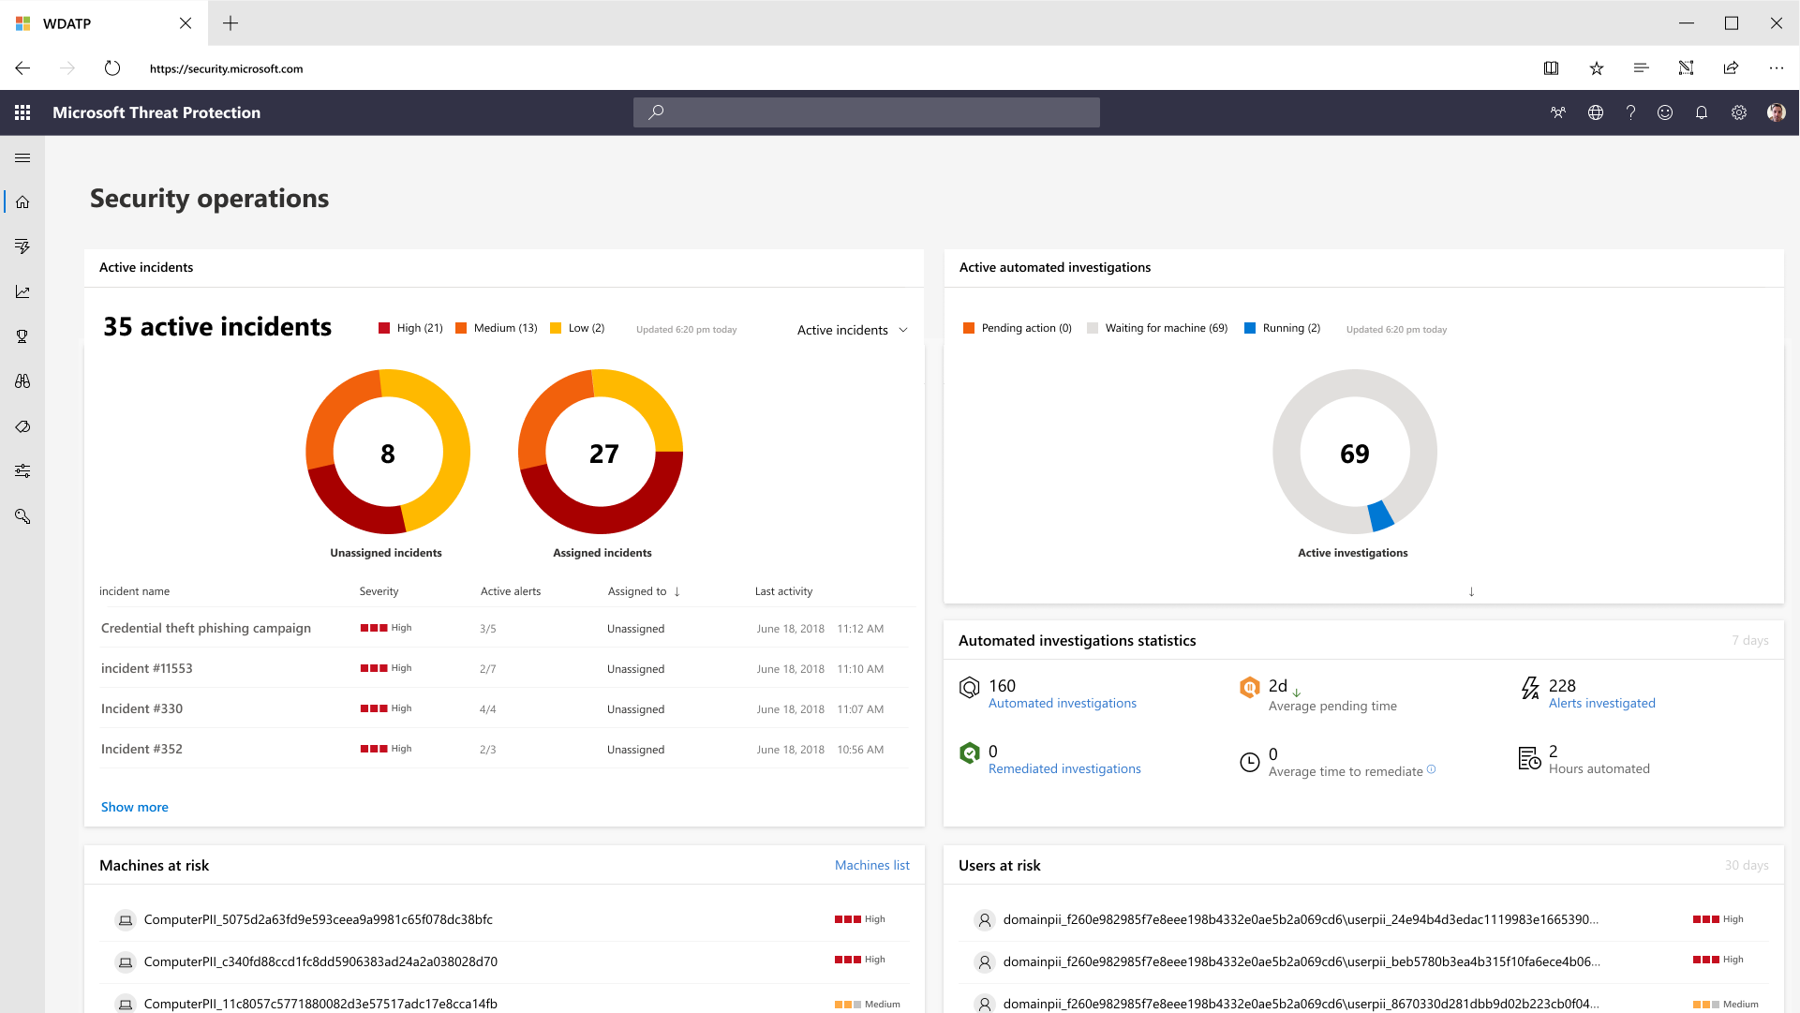
MTP Dashboard
Security Operations Dashboard

Slide 17
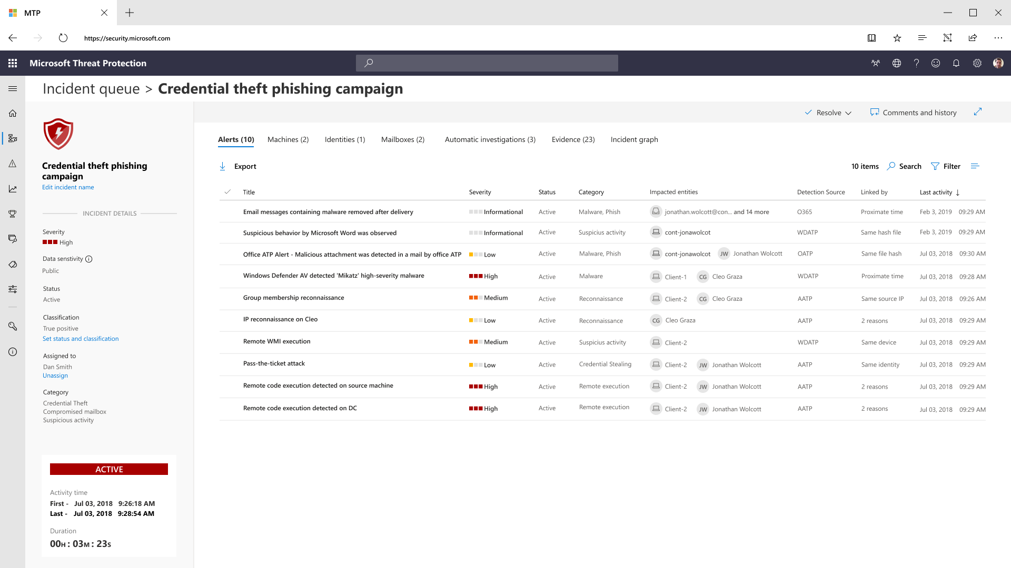
Cross-workload Incidents

Slide 18
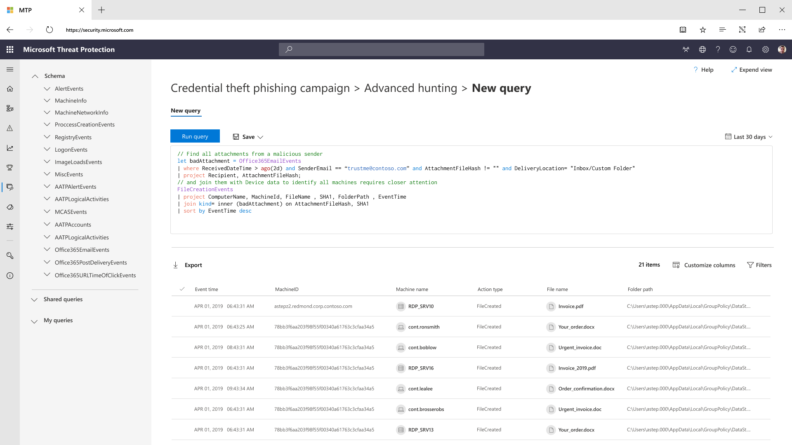
Cross-workload Hunting

Slide 19
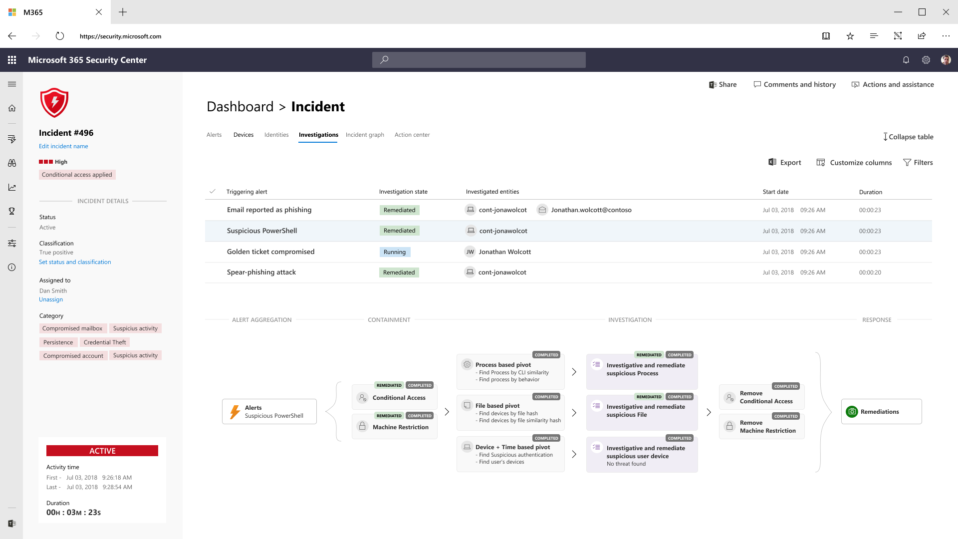
Cross-workload Automated Investigation and Remediation

Slide 20
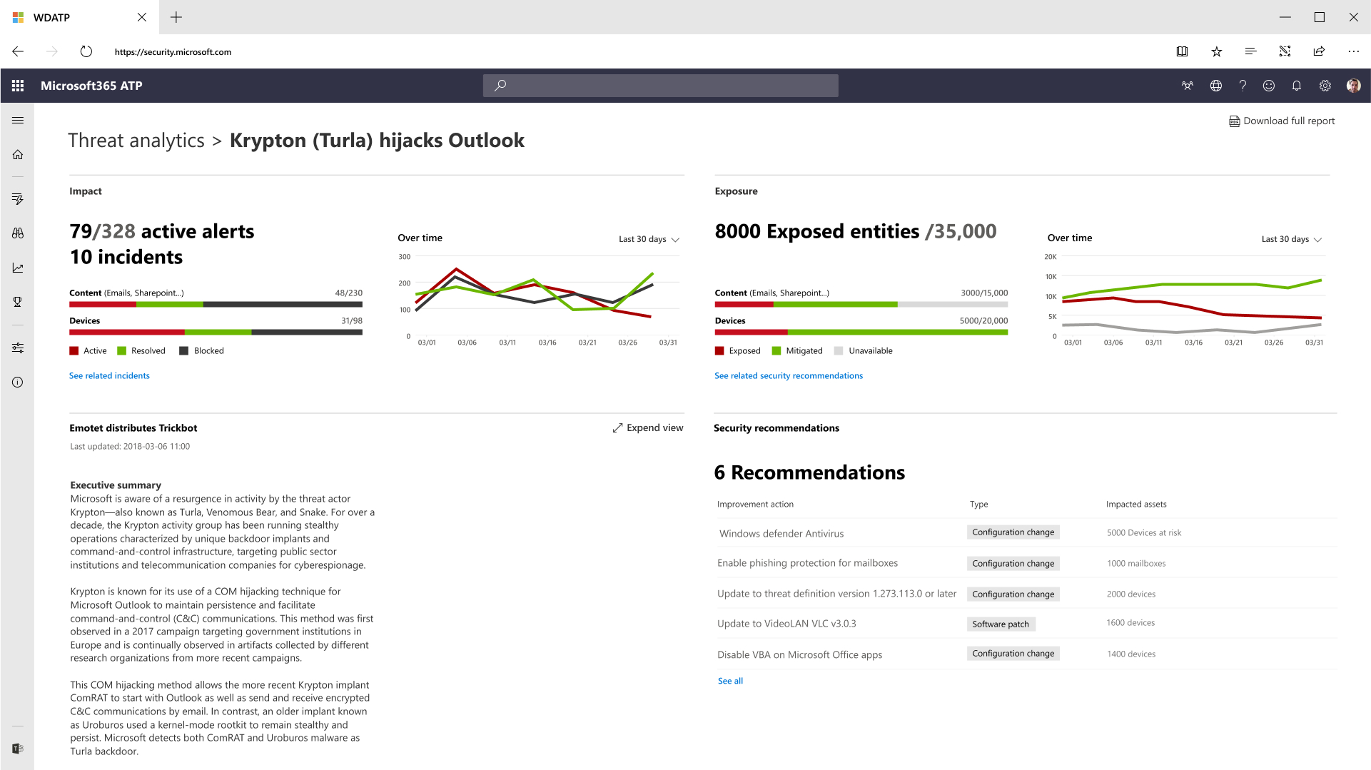
Cross-workload Threat Analytics

Slide 21
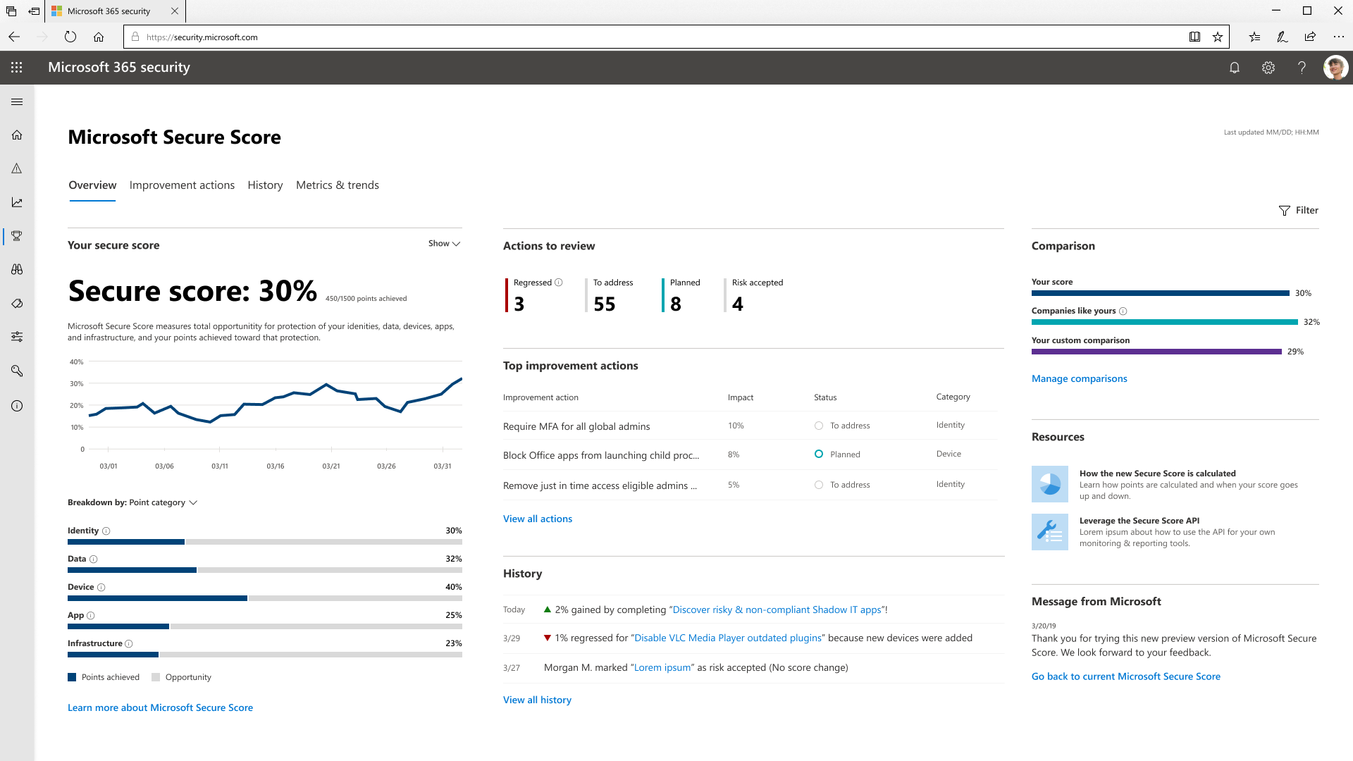
Microsoft Secure Score

Slide 22
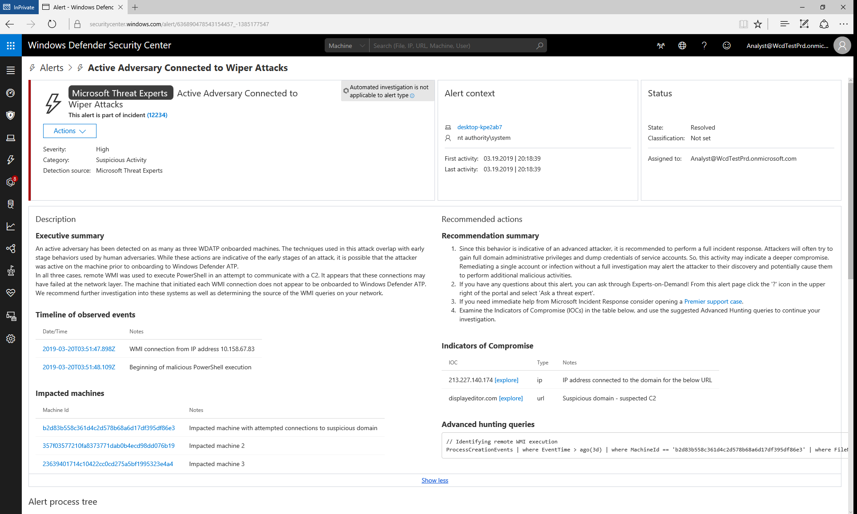
Targeted Notifications
Notes:
We have a great showcase of a Targeted Attack Notification identifying nation state activity that was sent to an MTE customer on March 21. Within 24 hours of their onboarding to the MTE service, 5 different teams across Microsoft collaborated to direct customer attention to a significant threat within their network.
Our Tier 1 team first discovered suspicious PowerShell commands running on three different machines in their organization, identified suspicious remote WMI commands that were the likely delivery vector, and highly suspicious external network attempts indicative of C2. Tier 1 worked closely with the Windows Defender Threat Intelligence team to attribute events to the Nation State adversary named Holmium and immediately escalated the incident to the MTE Tier 2 team with critical priority. While the three teams worked together to weave a narrative for the incident, MSTIC and CELA were engaged through the Nation State Notification (NSN) process. Less than 12 hours after Tier 1 noticed the suspicious activity, a high quality alert was sent to the customer.

Slide 23
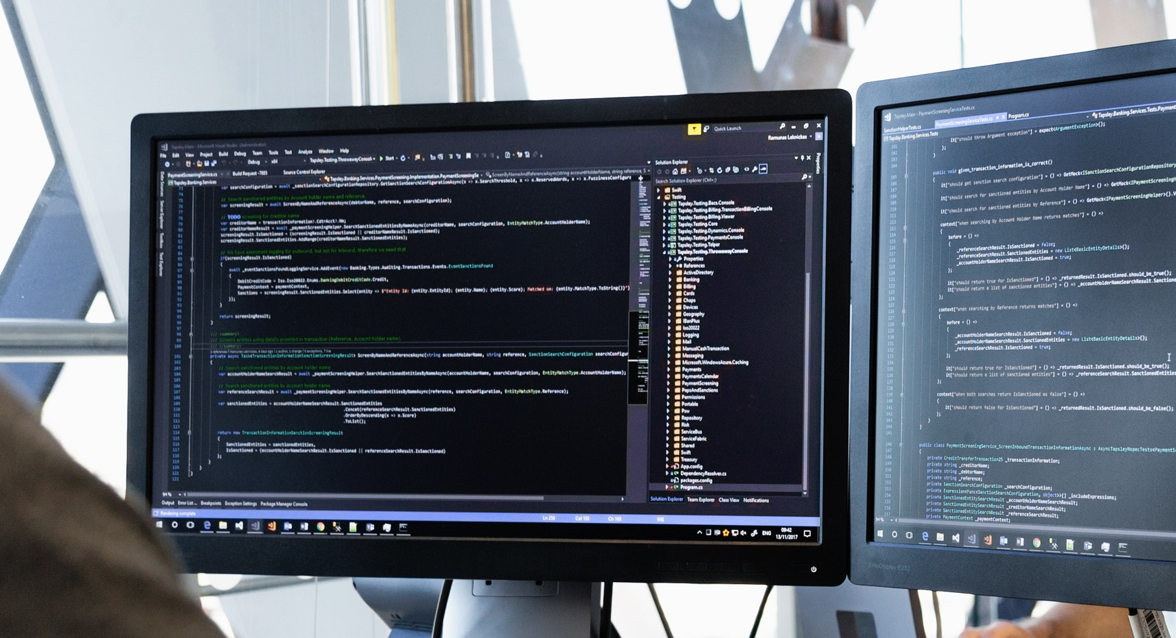

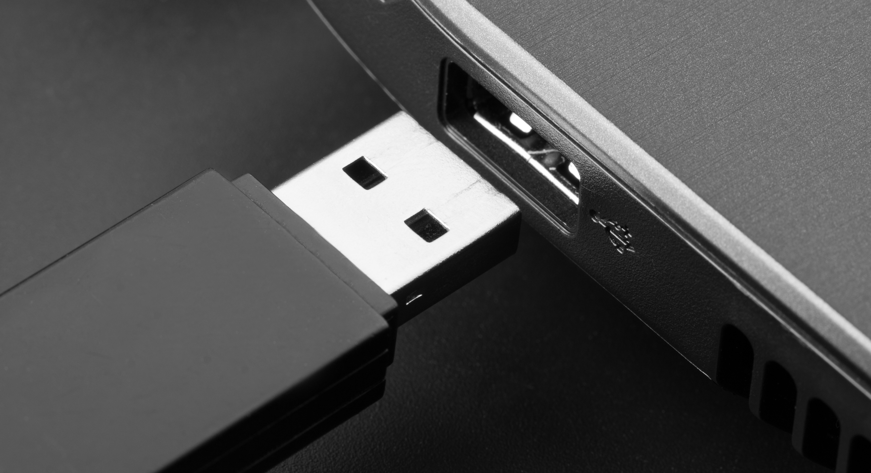
Real world investigation
Notes:
And it really works!
Not only customers catching things, but we are able to help
Stolen admin credentials and broke in through open RDP ports --- left over infrastructure
USB Keys, followed by advanced, fileless attack
Powershell tools to harvest and exfiltrate credentials
Our vision is to give you access to the insights of our talented security professionals
Ask a question
Extra notification
More later

Slide 24
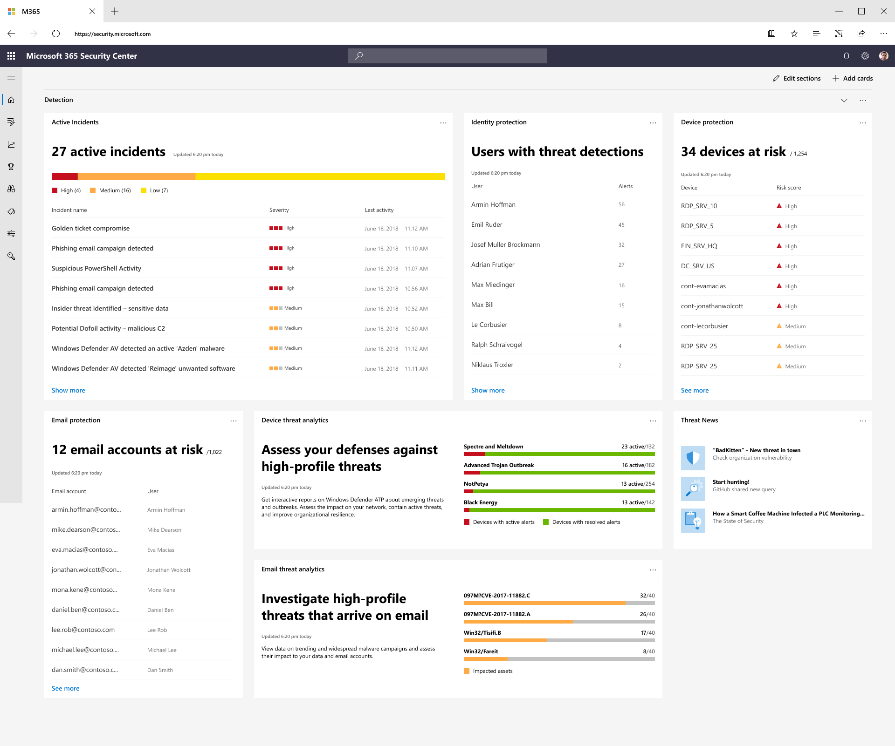

Slide 26
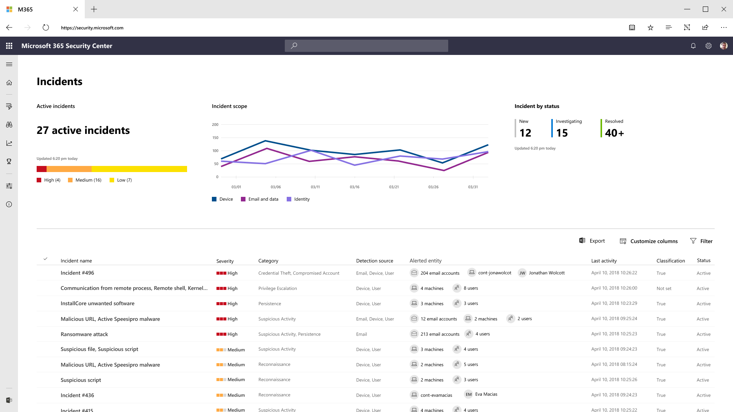

Slide 28
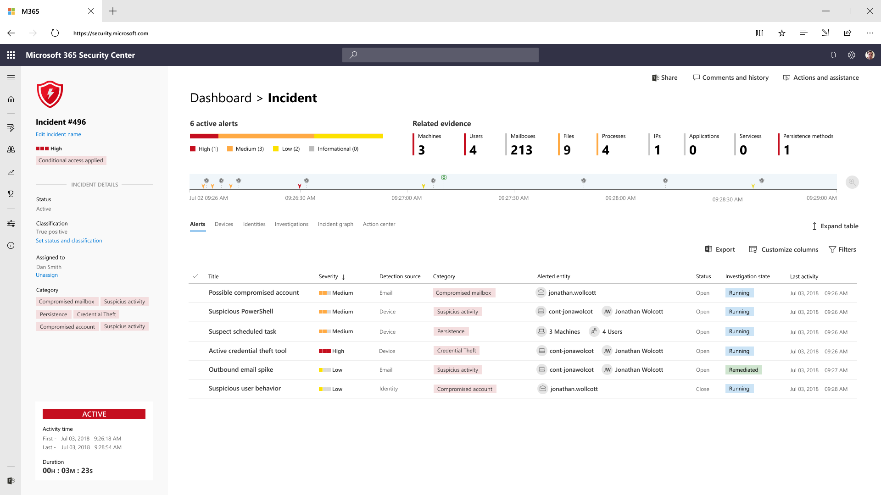

Slide 29
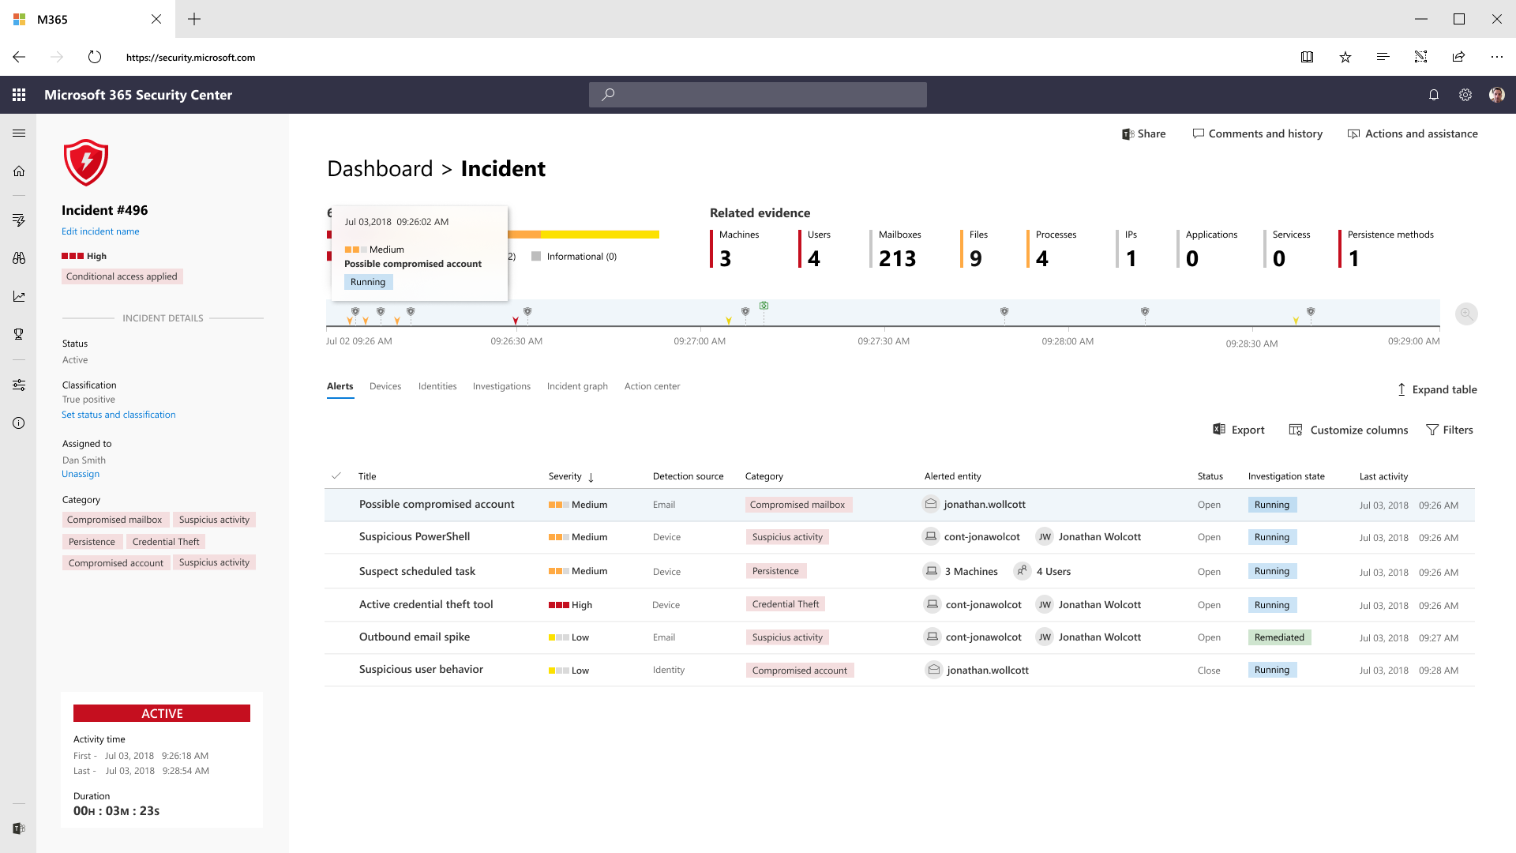

Slide 30
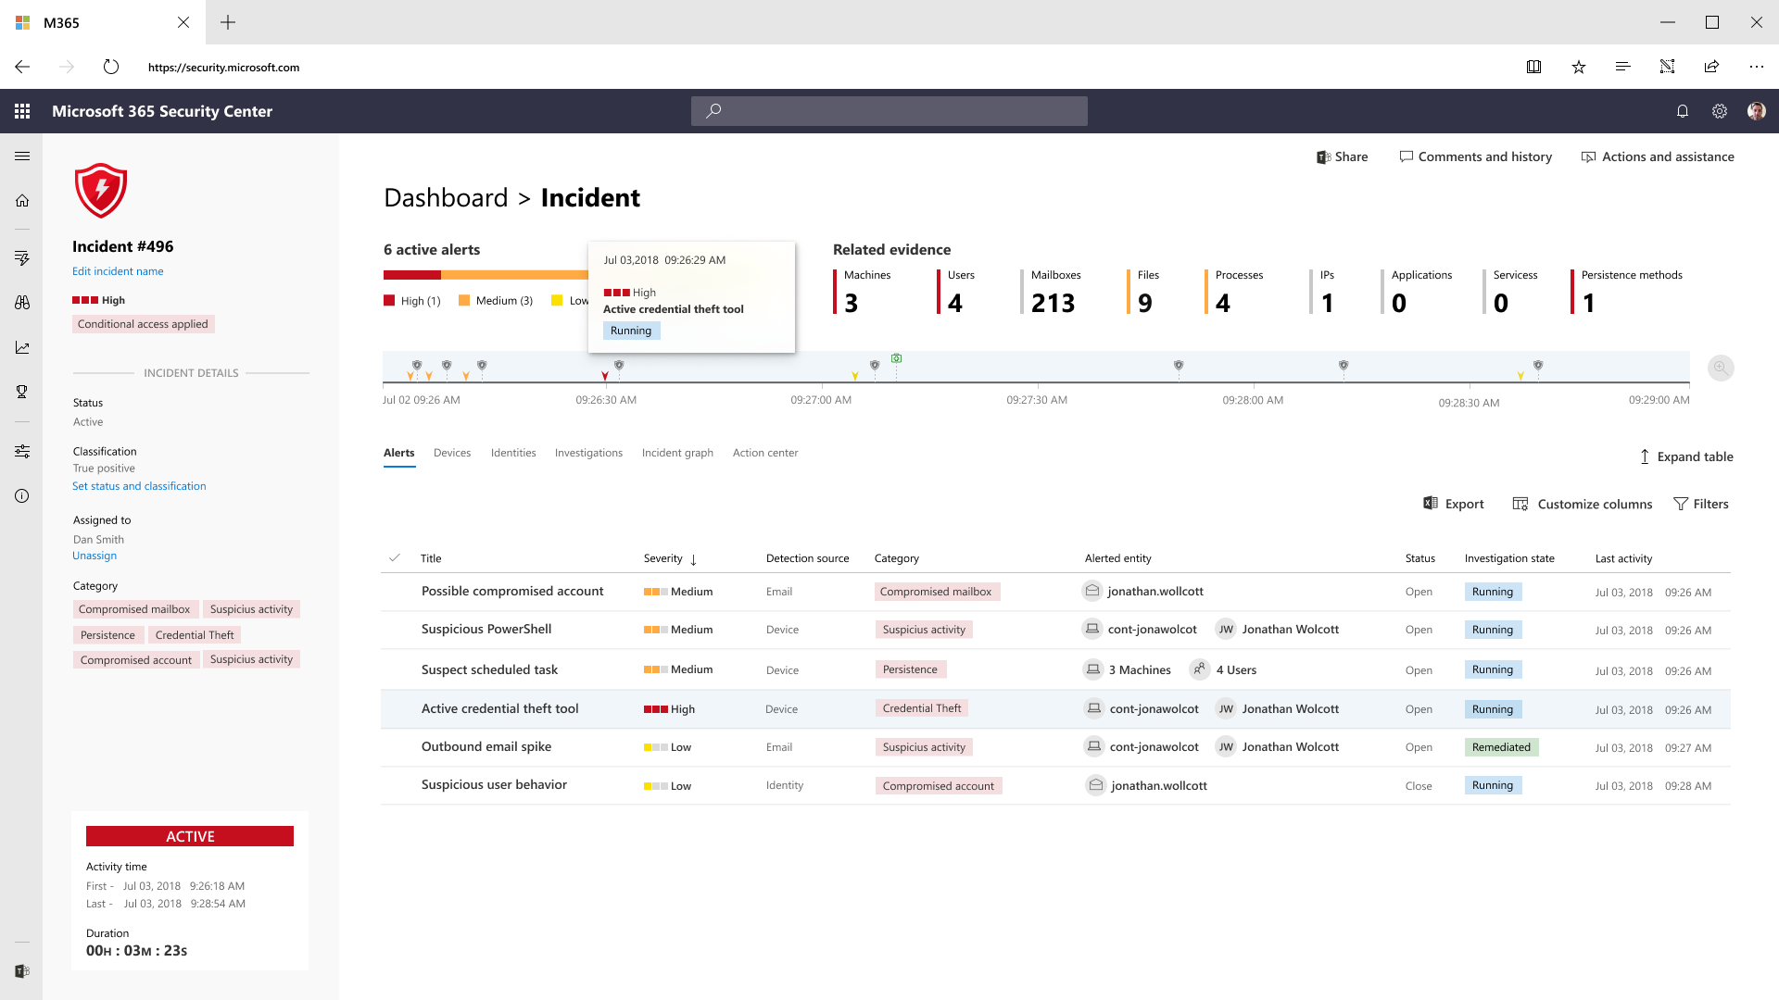

Slide 31
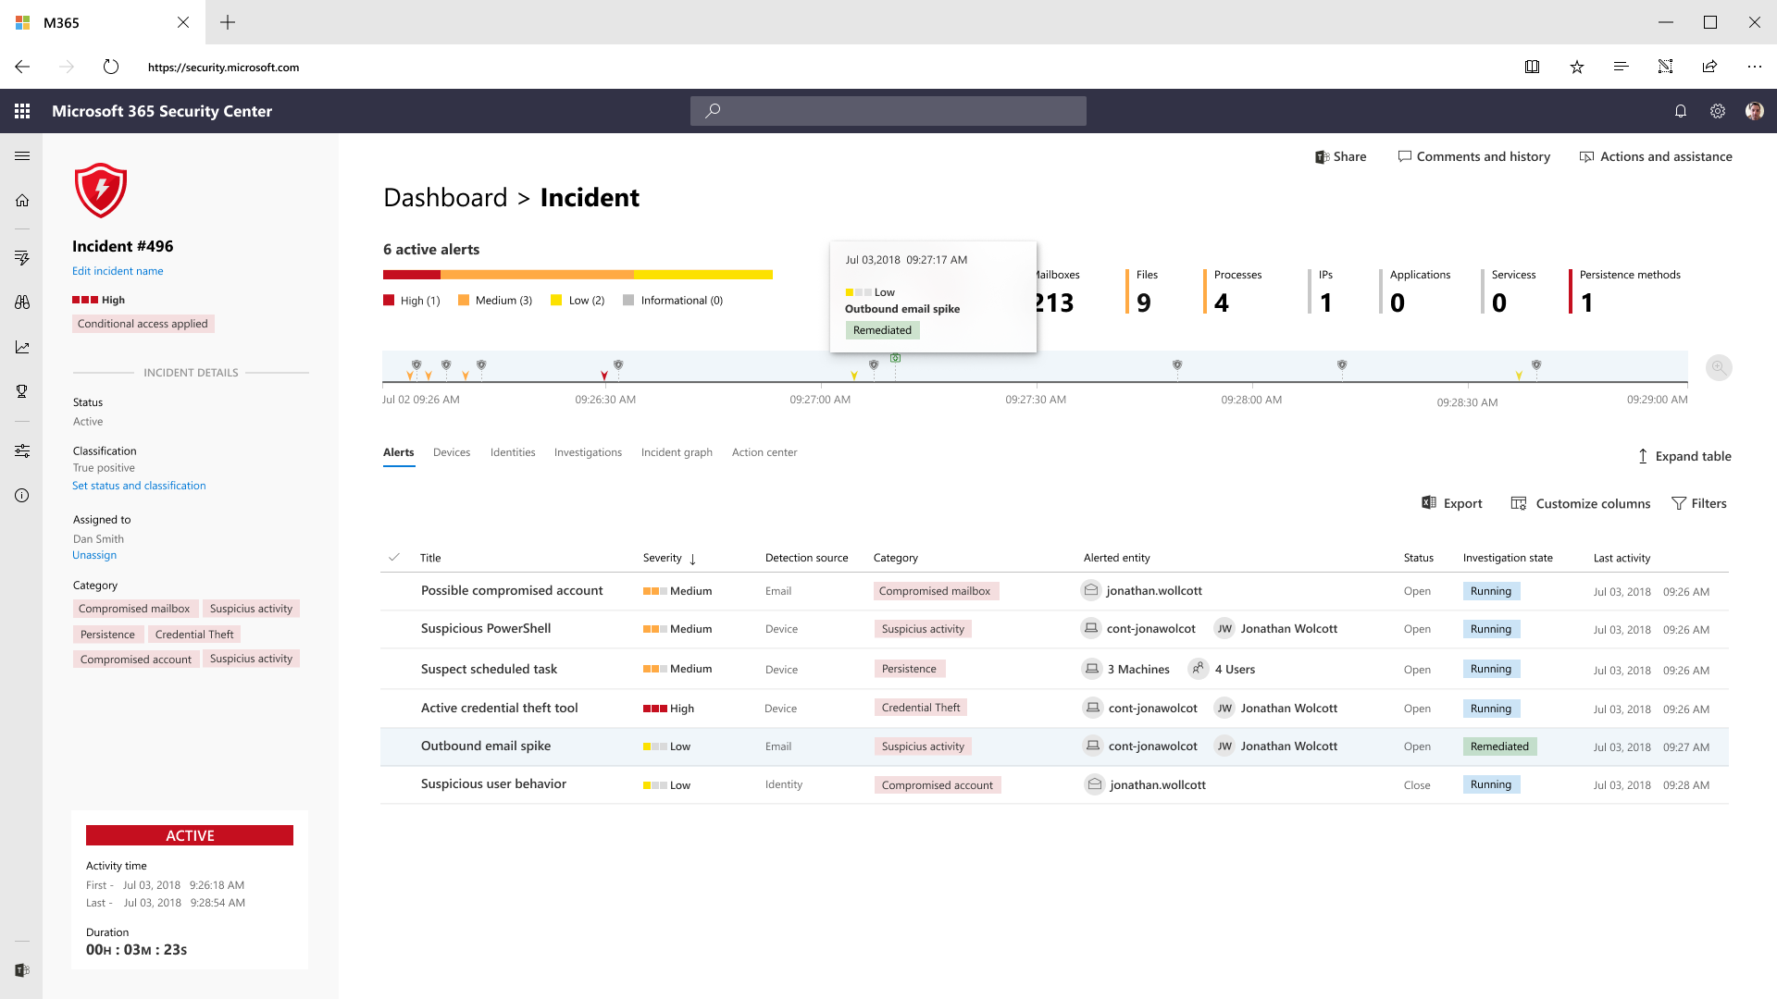

Slide 33
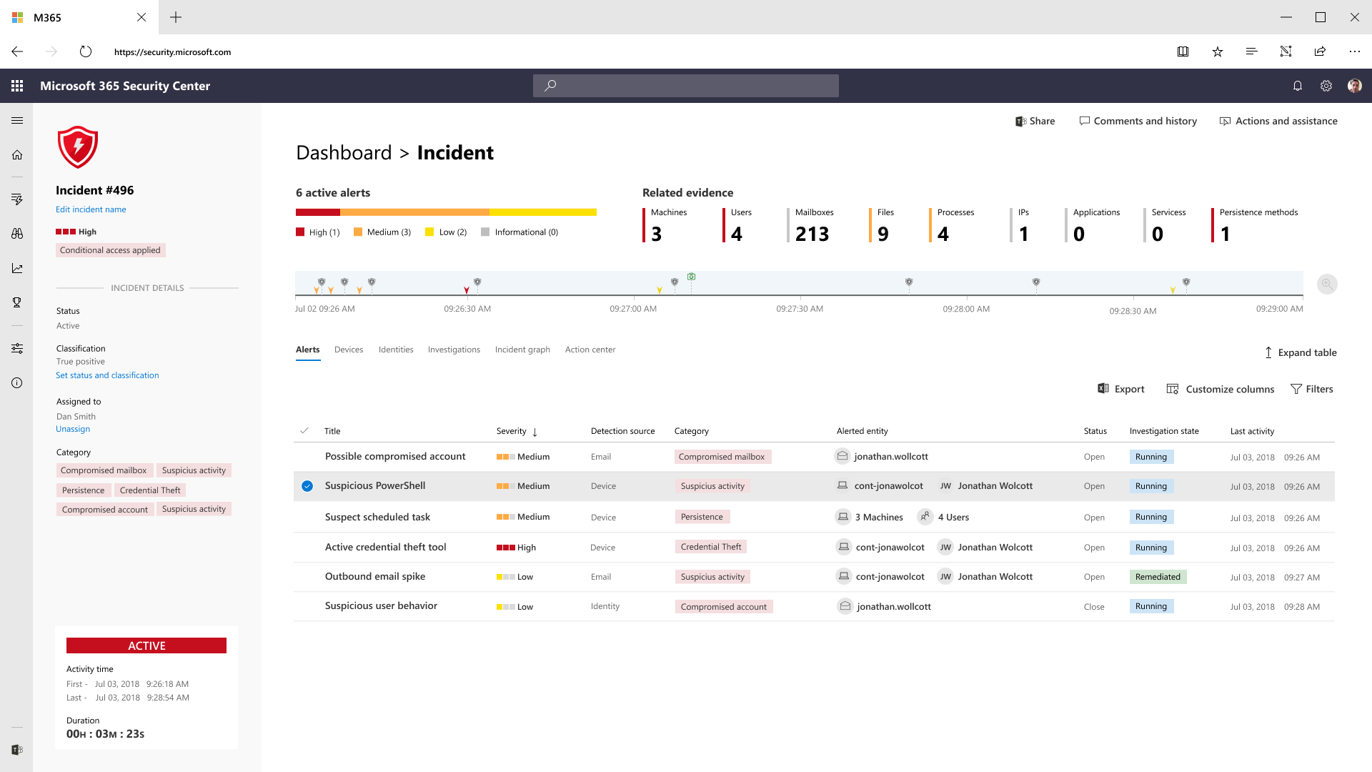
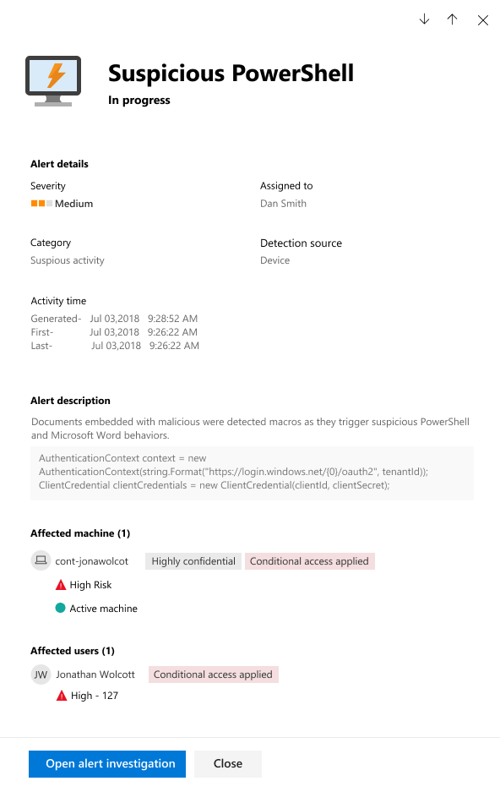

Slide 34
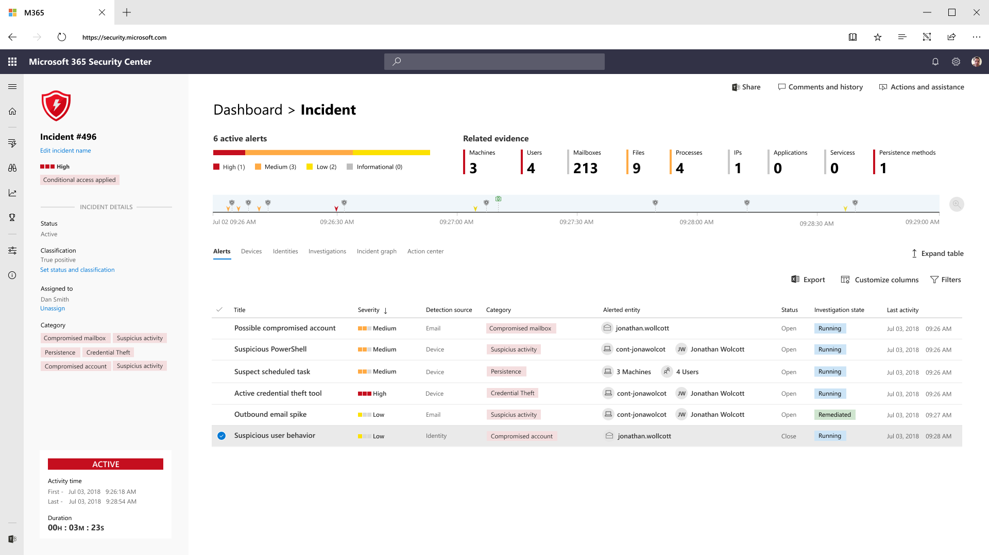
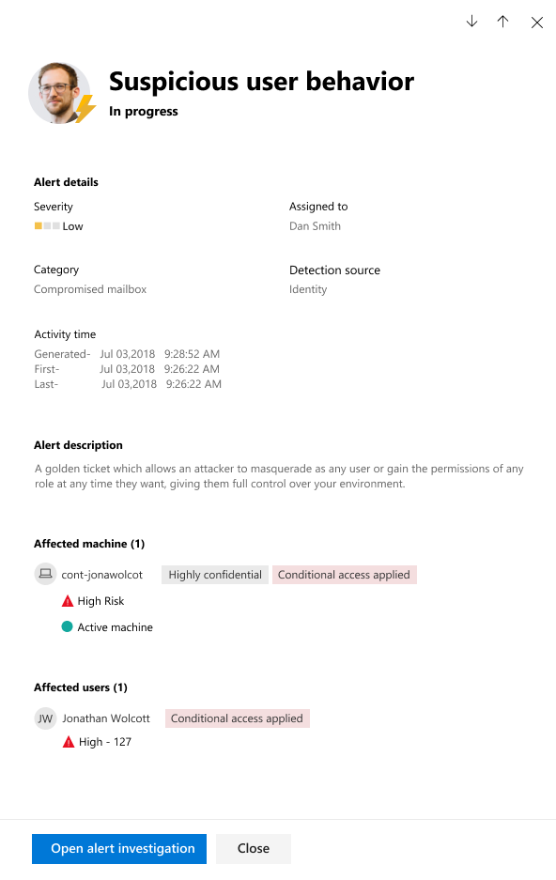

Slide 35
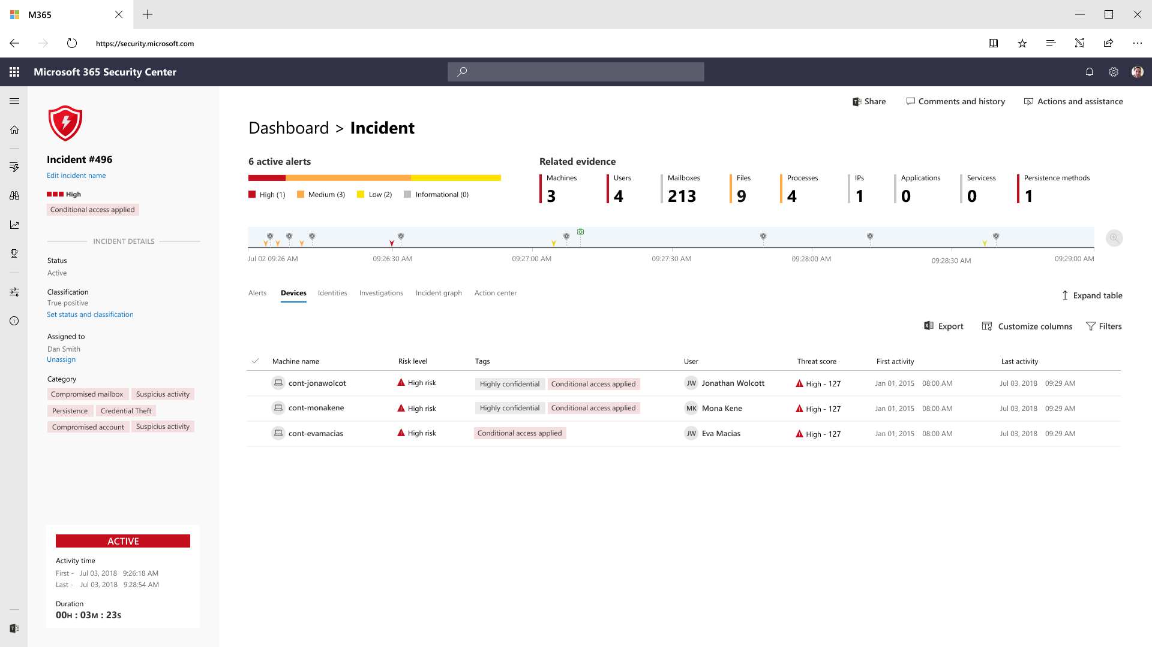

Slide 36


Slide 37
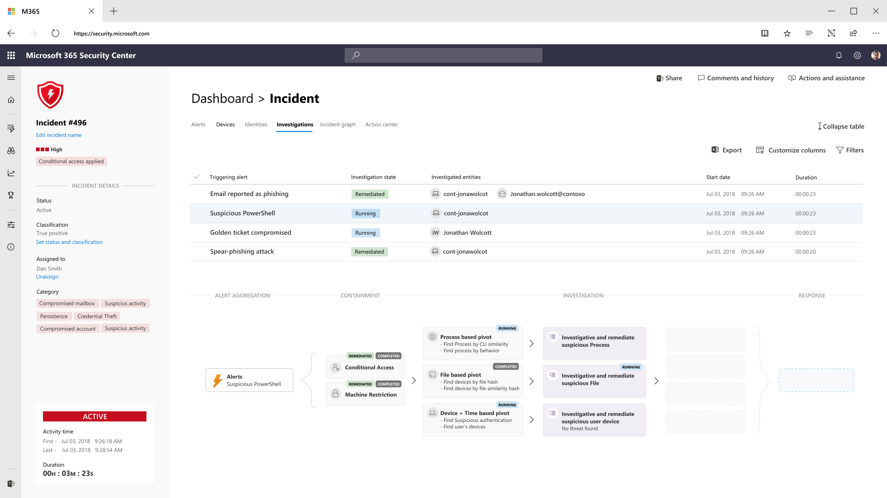

Slide 40
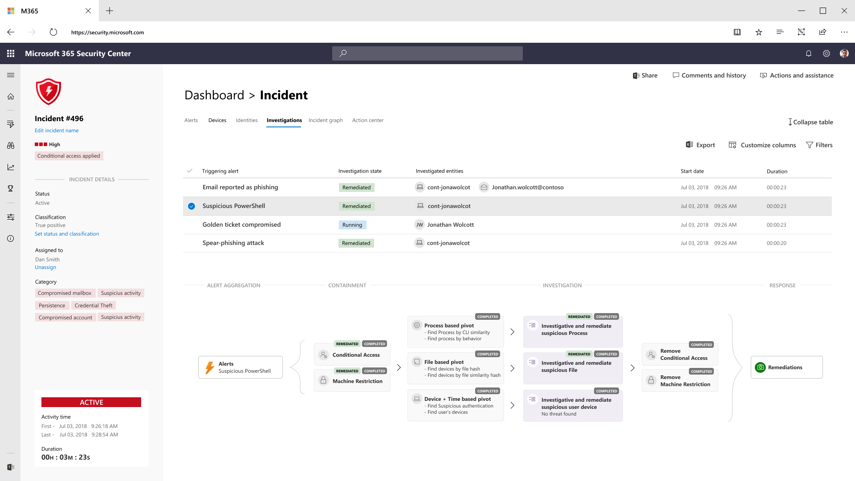
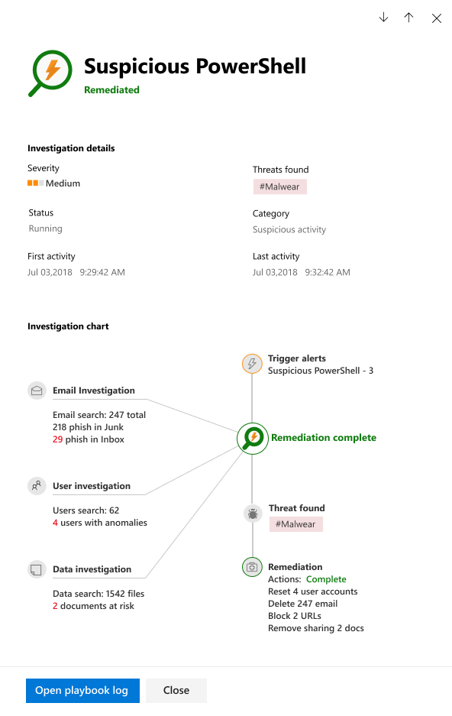

Slide 43
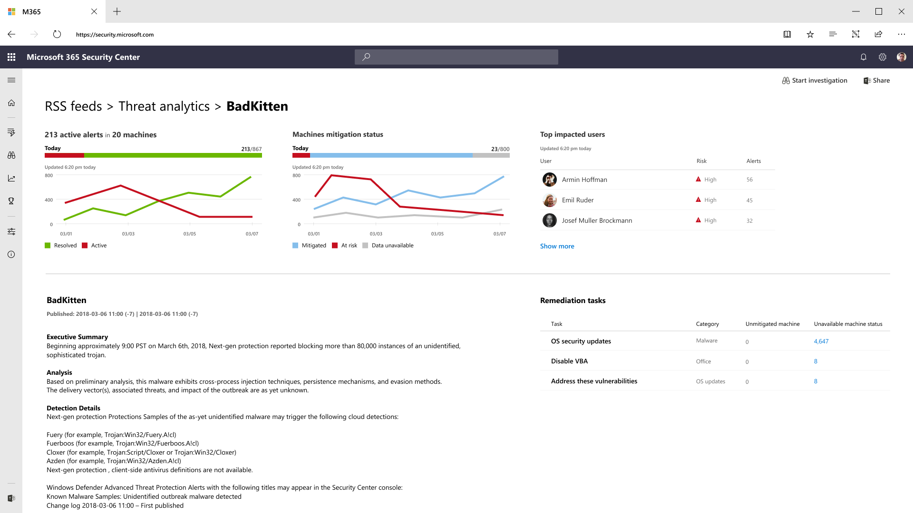

Slide 45
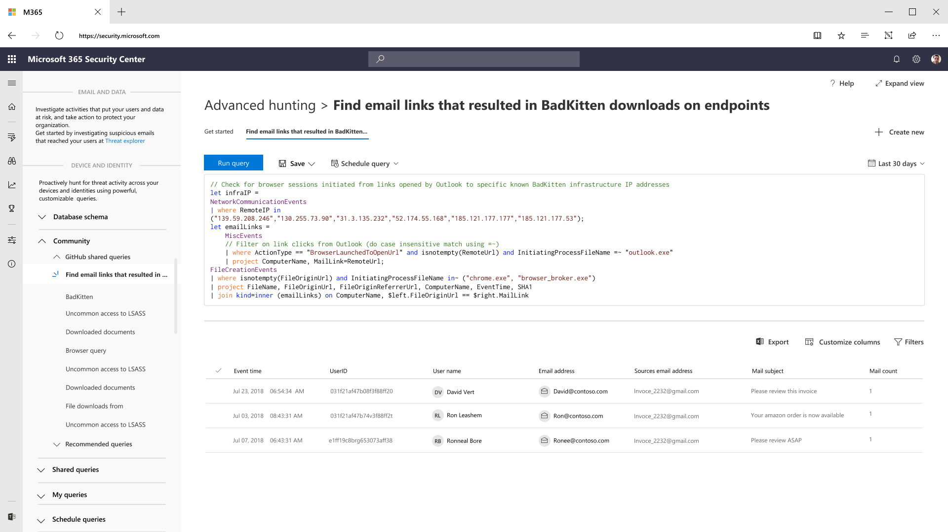

Slide 47
Emotet (2014)
Notes:
Emotet - Trojan

Slide 48
questions

Slide 49
thank you

